Slide 1

Sant Gajanan Maharaj Rural Polytechic, Mahagaon .
WELCOME
…..…..

Slide 2
Virtual mouse project guide: mr. r. b. more
Team Members:
Vishal Bhimgonda Desai
Rakesh Mahadev Bandi
Prajwal Sadashiv Chilami
Rohit Sanjay Gorule

Slide 3

Chapter1: industry layout.
Index
-
-
Abstract
Problem statement
System requirement
Block diagram
Implementation
Output
Application
Advantages
Limitations
Future scope
Conclusion
Reference
-
-
SparkLab IT Solutions Pvt.Ltd (CEO- Prashant Rajaram)
Training(Head: Rohit Pote)
Development
(Head: Ketan Gorule)
Inhouse Training (X ) Corporate Training (Y)
Team Lead (A)
Tech Lead(B)
Marketing head (C)

Slide 4
1. Abstract
In this project, we design a human computer interaction system using hand gestures. Hand gesture recognition (HGR) is a natural way of Human Machine Interaction and has been applied on different areas. Here we explore the use of hand gestures as a means of human-computer interactions for computer applications. Our goal is to make a system that will recognize a few sets of hand gestures and correspondingly realize the robust control of mouse cursor and mouse clicks with a higher accuracy of gesture recognition. More specifically it is the use of a convolution neural network (CNN) to recognize the hand gestures in even the harshest lightning/background conditions using only a simple webcam. We will try to adjust the cursor control to the relative movement of our specific gesture set for mouse movement and different mouse events like clicks to different gestures. The final system will be highly extendable and can be further implemented in advanced technologies like augmented reality (AR), virtual reality (VR) for easy and hassle-free navigation and control without the need for keyboard/mouse for computers and controllers for VR/AR headsets.

Slide 5
2.Problem statement
Background:
Traditional computer mice have been widely used as input devices for interacting with computers. However, certain situations, such as limited desk space or physical disabilities, can make using a traditional mouse challenging. In such cases, a virtual mouse system can provide an alternative input method, enabling users to control the mouse cursor using gestures or other non-traditional inputs.
Problem:
Design and implement a virtual mouse system that allows users to control the mouse cursor on a computer screen without physically manipulating a traditional mouse. The system should be intuitive, accurate, and adaptable to different user preferences and environments. Key challenges to address include gesture recognition, cursor movement precision, and user interface design for configuration and calibration.
Notes:
Consider talking about:
Financial aid

Slide 6
3. System requirement
Software Requirements:
1. VSCODE EDITOR.
2. OPEN-CV LIBRARY.
3. NUMPY LIBRARY.
4. MEDIAPIPE LIBRARY
5. AUTOPY LIBRARY
Hardware Requirement:
1. Hard disk : 500GB and above
2. RAM : 8GB and above
3. Processor : i5

Slide 7
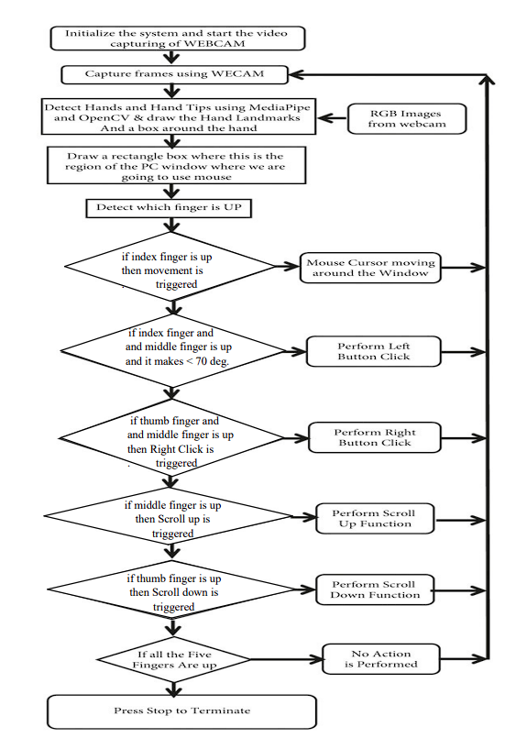
4. Block diagram
Software testing:
Software testing is a set of pSoftware testing:
Software testing is a set of processes aimed at investigating, evaluating and ascertaining the completeness and quality of computer software. Software testing ensures the compliance of a software product in relation with regulatory, business, technical, functional and user requirementsrocesses aimed at investigating, evaluating and ascertaining the completeness and quality of computer software. Software testing ensures the compliance of a software product in relation with regulatory, business, technical, functional and user requirementsSoftware testing:
Software testing is a set of processes aimed at investigating, evaluating and ascertaining the completeness and quality of computer software. Software testing ensures the compliance of a software product in relation with regulatory, business, technical, functional and user requirements

Slide 8
5. Implementation
OPEN:
When run the .py file :GUI will be open.
2. CLICK ON TRACK MOUSE BUTTON
Webcam will be open to capture hand gestures.
3. NO ACTION PERFORMED
When all the five fingers up then the cursor will stop to moving
4. CURSOR MOVING
For this action we have to use the index finger.
5. LEFT BUTTON CLICK
Lower the index finger and raise the middle finger.
Software testing:
Software testing is a set of pSoftware testing:
Software testing is a set of processes aimed at investigating, evaluating and ascertaining the completeness and quality of computer software. Software testing ensures the compliance of a software product in relation with regulatory, business, technical, functional and user requirementsrocesses aimed at investigating, evaluating and ascertaining the completeness and quality of computer software. Software testing ensures the compliance of a software product in relation with regulatory, business, technical, functional and user requirementsSoftware testing:
Software testing is a set of processes aimed at investigating, evaluating and ascertaining the completeness and quality of computer software. Software testing ensures the compliance of a software product in relation with regulatory, business, technical, functional and user requirements

Slide 9
6. RIGHT BUTTON CLICK
For this action first we have to show thumb and middle finger then use the index finger.
7. SCROLLING
Scroll down: for this action we have to make fiest and show the thumb.
Scroll up: for this action we have to make fiest and show the middle finger.
8. DRAG AND DROP
we use the last finger for the selection of the content and then by using index finger move the content.
9. DOUBLE CLICK
Join/closed both index finger and middle finger then double click action perform.

Slide 10
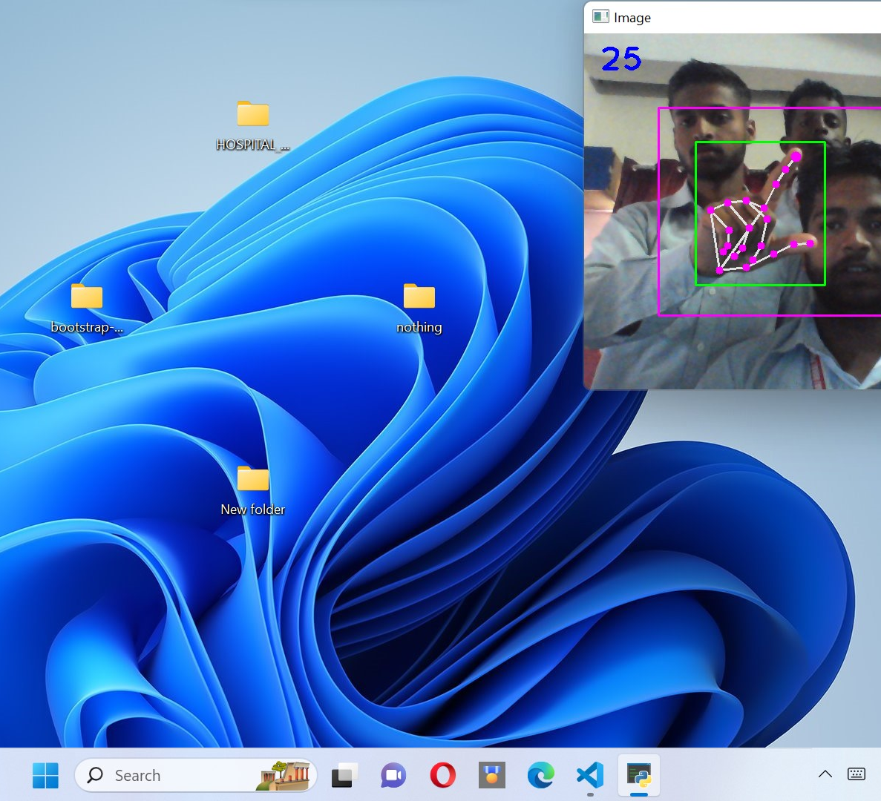
6. output
Single click

Slide 11

Double click

Slide 12
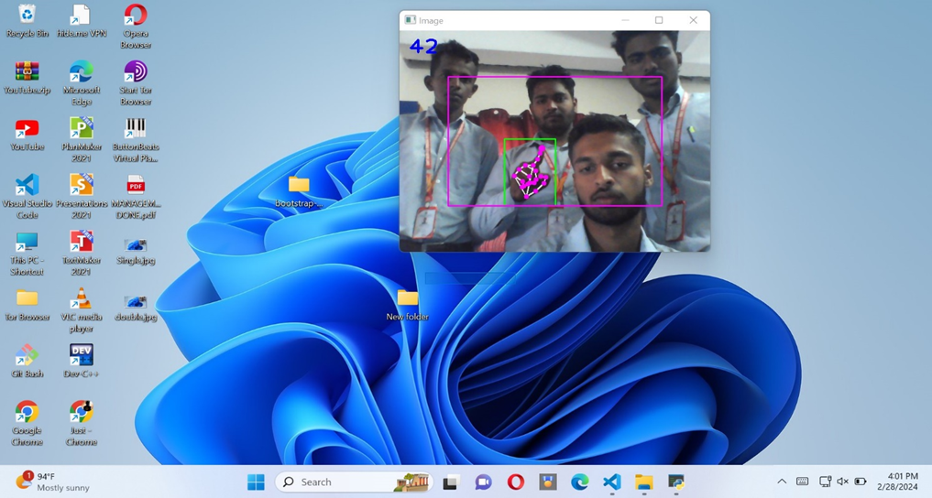
Drag and drop

Slide 13
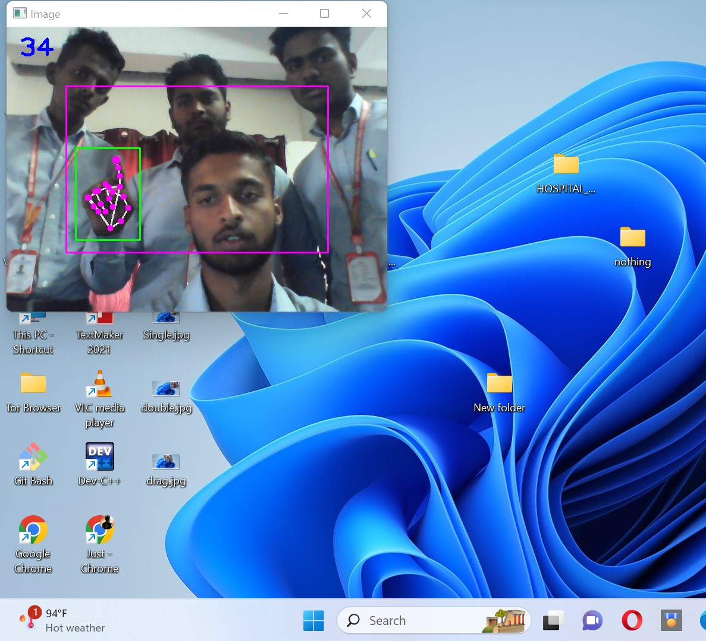
Right click

Slide 14
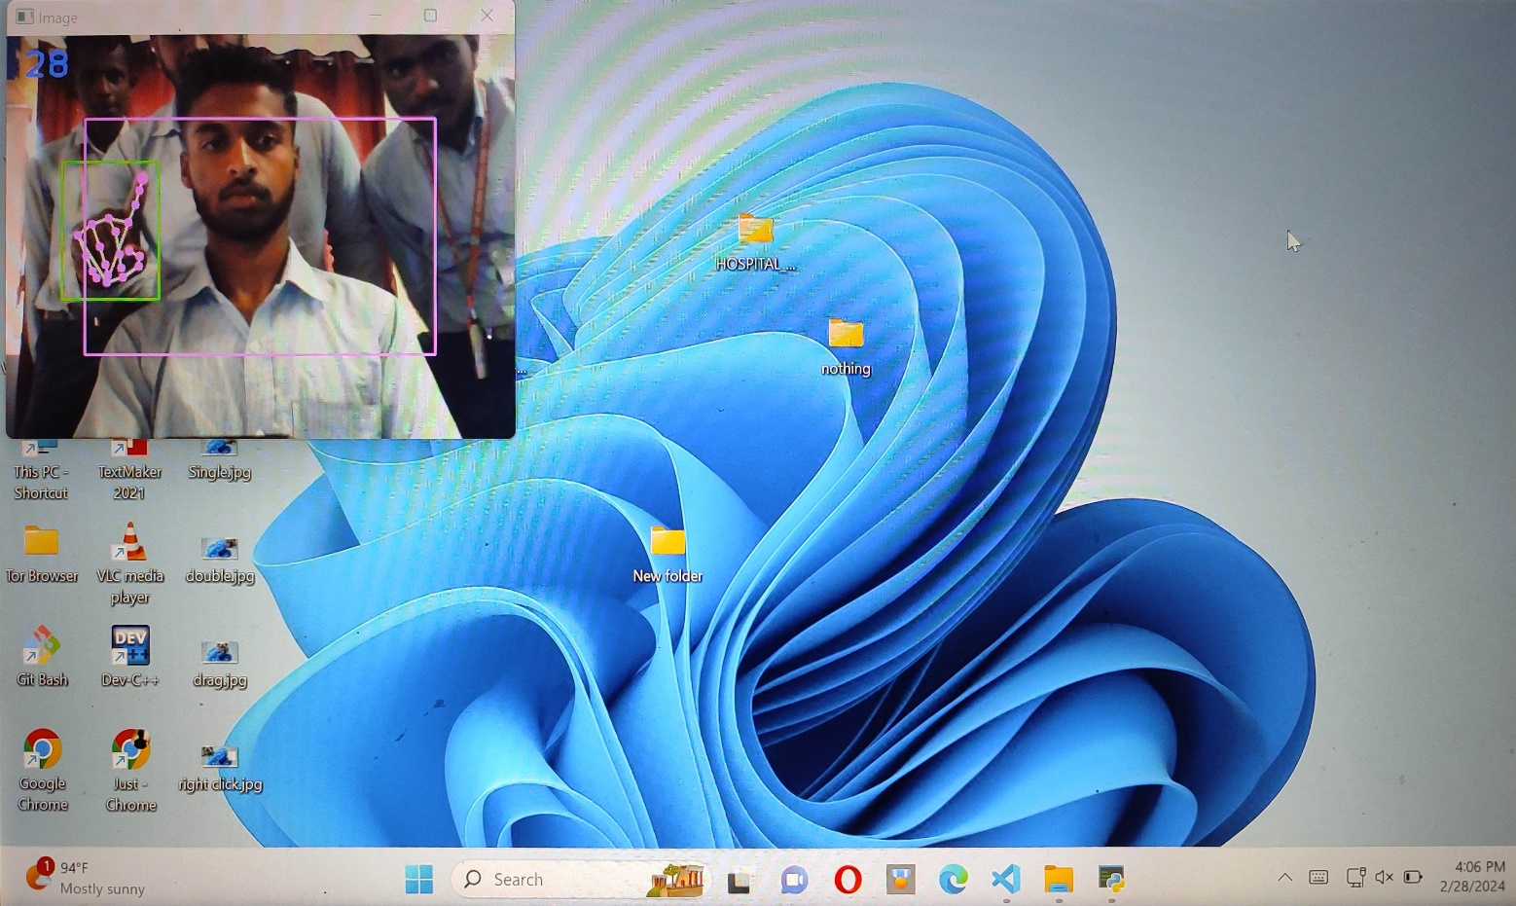
movement

Slide 15
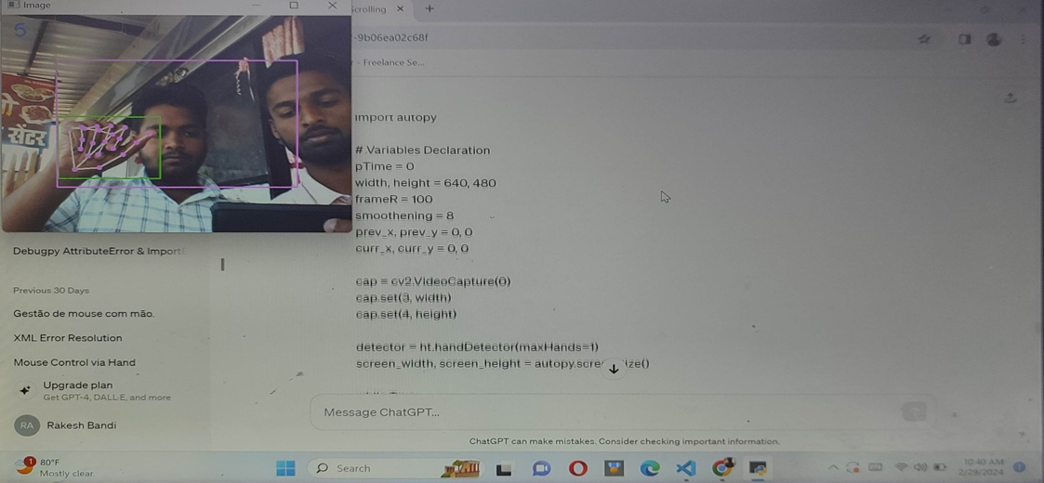
Scrolling

Slide 16
7. Applications
1. Remote Control
2. Gesture-Based Interaction
3. Healthcare
4. Gaming

Slide 17
8. advantages
1. Playing games
Virtual mice can be used to play virtual reality and augmented reality games without a physical mouse.
2. Controlling the mouse
People with hand problems can use a virtual mouse to control their computer’s mouse functions.
3. Reducing the spread of COVID-19
Virtual mice can be used to reduce the spread of COVID-19 by eliminating the need for a physical mouse.

Slide 18
9. Limitations
small decrease in accuracy in right click mouse function and some difficulties in clicking and dragging to select the text.
2. Factors such as poor lighting, backgroung clutter, or interference from other objects may affect accuracy.

Slide 19
10. Future scope
VR and AR games :
This concept is used to play the games with VR and AR technololgy.
Robotics and automation :
This concept is used to handle the robots without any physical device.

Slide 20
11. conclusion
virtual mouse project implemented in Python using hand gestures represents a significant leap forward in human-computer interaction technology. By harnessing the power of computer vision and machine learning algorithms, this project offers users a novel and intuitive method of controlling their devices without the need for traditional input devices such as a physical mouse or touchpad

Slide 21
12. References
Other References:
1. http://www.w3schools.com/
2. http://stackoverflow.com/
3. https://www.geeksforgeeks.org/ai-virtual-mouse/
4. http://www.vogella.com/tutorials/dotnet/artcle.html
5. https://www.btechsmartclasses.com/
6. https://chat.openai.com/

Slide 22
THANK YOU ...

